Slide 1
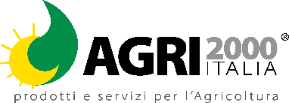
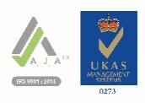
SULFURIC ACID
For cleaning the systemsmicro-irrigation
Packages: 12 - 25 - 370 - 1300 Kg
COMPOSITION:
Sulfur trioxide (soluble SO₃)in the water | 40%
48/50% aqueous solution of H₂SO₄
TECHNICAL FEATURES:
Sulphuric acid is used as an acidifier and mainly, when irrigating with ferrous water, to prevent or remove iron deposits from the sprinklers of drip or rotary irrigation systems.micro-spraying.
PHYSICAL CHARACTERISTICS:
Specific weight: 1.1 gr/ml
METHOD AND DOSAGE OF USE:
RADICAL APPLICATION
Allthe crops: | for intervention | 3-5 kg/ha
 | depending onof the iron content of the irrigation water | 0.3-1%
AGRI 2000 ITALIA SRL
Via Nagliati 87 44033-Alberone di Riva del Po (FE)
Tel. 0532 874223 email. info@agri2000italia.com

